Slide 1

Cloud Stream Pro A Hybrid Cloud-Native Multimedia Sharing Platform
COM682 – Cloud Native Development
Student Name : Israth Jahan Juhi
Student ID : B00969342

Slide 2
Contents
Introduction
Problem Definition
Solution Architecture
Azure Architecture Diagram
WordPress Stack & Plugins
Web Applications Wireframes
Database Schema (ERD)
Database Design Rationale
REST API (CRUD) – Diagram
Scalability Evaluation
Reliability & Security
Limitations & Mitigation
Reference

Slide 3
Goal
Develop a scalable and efficient cloud-native multimedia sharing platform using Microsoft Azure.
Objectives
Enable upload, view, update, and delete (CRUD) of multimedia content
Use Azure Blob Storage, Cosmos DB, and serverless APIs
Ensure scalability, performance, and cost efficiency
Result
A working cloud-hosted dashboard that demonstrates a fully functional, scalable multimedia sharing system using cloud-native technologies.

Slide 4
Problem Definition
Modern multimedia applications face several challenges:
* Large storage required for images, videos, and other media
* High number of users accessing the system at the same time
* Sudden traffic spikes that can slow down or crash the system
* Traditional systems are difficult to scale up or down
* High infrastructure and maintenance costs
* Manual management of servers and resources
* Slow performance when handling large files
* Limited availability and reliability in non-cloud systems
Therefore, a cloud-based solution is needed to provide better scalability,
performance, reliability, and cost efficiency for managing multimedia content.

Slide 5
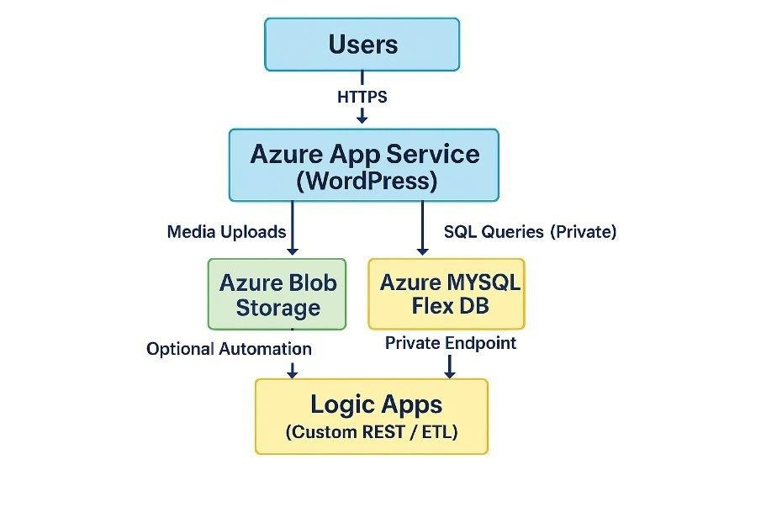
Solution Architecture
* Users access the app through the internet (HTTPS)
* The web app runs on Azure App Service (WordPress)
* Media files are stored in Azure Blob Storage
* Data is stored in Azure MySQL Database
* The database is secured using a Private Endpoint
* Logic Apps are used for automation (optional)
This setup makes the system secure, scalable, and easy to manage.

Slide 6
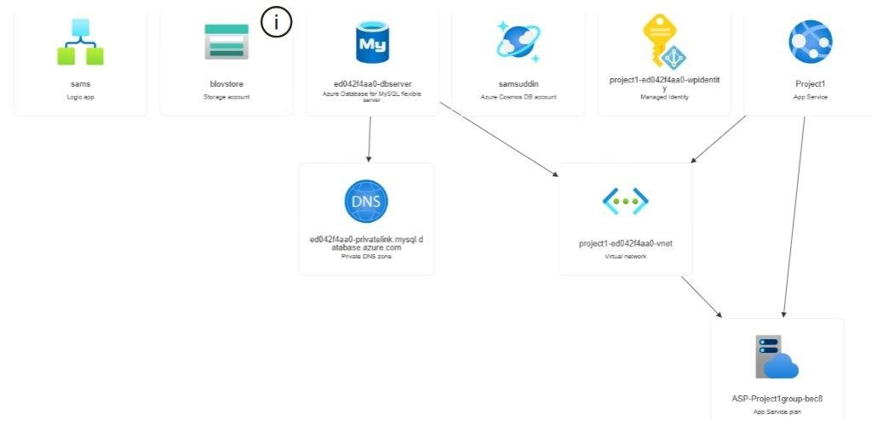
Azure Architecture Diagram User uses the app by using word press App stores files in Blob Storage App connects to MySQL securely App uses Managed Identity for access connects to external services

Slide 7
WordPress Plugins
WordPress Stack
Frontend: WordPress (UI for users)
Hosting: Azure App Service
Database: Azure MySQL Flexible Server
Storage: Azure Blob Storage (for media files)
Security: HTTPS + Private Endpoint + Managed Identity
Automation: Azure Logic Apps (optional)
For Media Storage WP Offload Media Lite → Stores media files in Azure Blob Storage
For Security WordFence Security → Protects website from attacks 🔹 For Backup
For Backup UpdraftPlus → Backup and restore data
For Performance WP Super Cache or W3 Total Cache → Improves website speed
For Forms / Uploads WPForms → Allows users to upload files easily

Slide 8
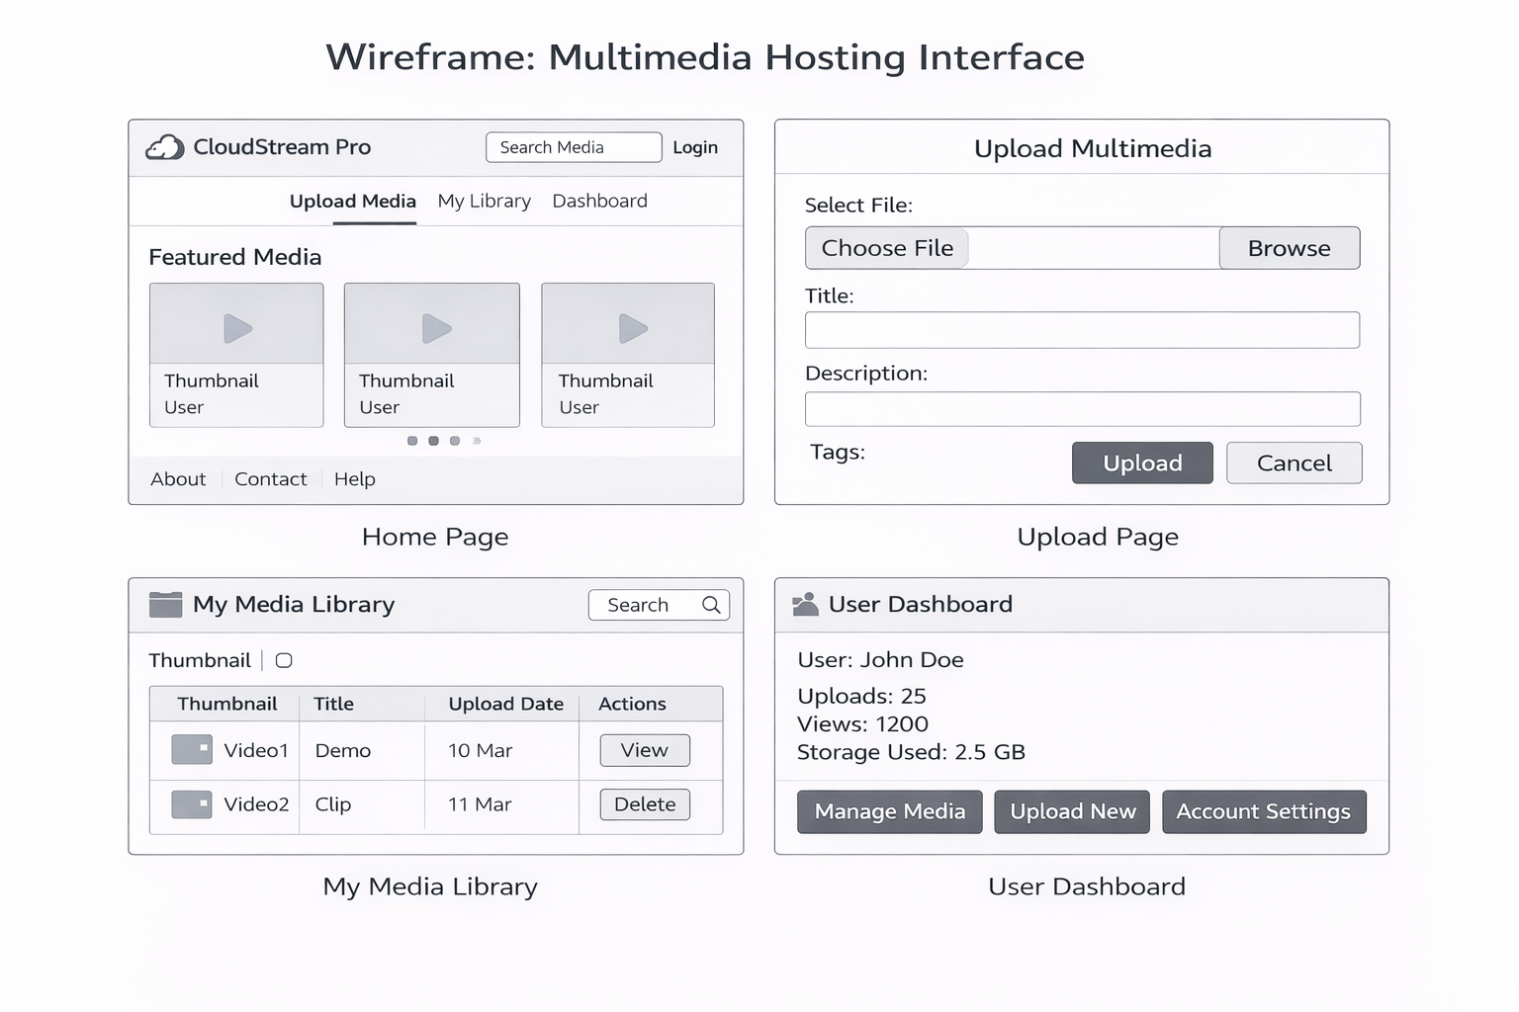
Web Application Wireframes

Slide 9
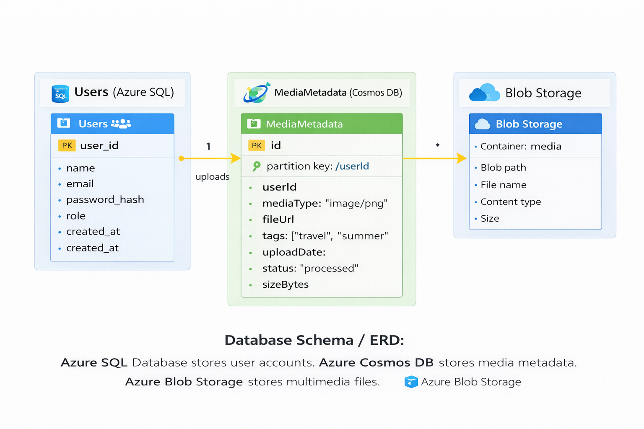
Database Schema
Azure SQL Database stores user information (name, email, password, role)
Each user can upload media files
Cosmos DB stores media details (file type, URL, tags, upload date, size)
It links each media file to a user using userId
Blob Storage stores the actual files (images, videos)
It keeps file path, name, and size

Slide 10
Database Design Rationale SQL + NoSQL + Object Storage
Azure SQL Database:
authentication and roles need structured schema + ACID guarantees [5].
Cosmos DB:
metadata benefits from flexible schema and horizontal partitioning; partition key = user Id to distribute load and avoid hotspots [4].
Blob Storage:
stores large binaries independently of compute; URLs stored in metadata to decouple files and records [3].

Slide 11
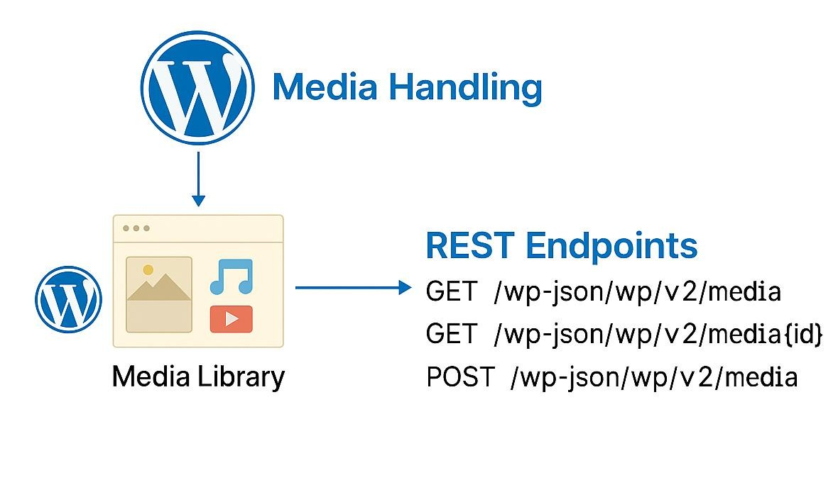
REST API (CRUD) – Diagram
The REST API is hosted on Azure App Service and exposes CRUD endpoints
for multimedia content management. The API stores files in Blob Storage,
metadata in CosmosDB and verifies user authentication through Azure SQL.

Slide 12
Scalability Evaluation
Compute: App Service scales out horizontally (multiple instances) for REST API throughput [1].
Event processing: Functions scale automatically based on trigger volume (burst handling) [2].
Storage: Blob Storage scales independently of compute and supports large binaries [3].
Database: Cosmos DB scales via RU/s throughput; partitioning enables distributed load [4].
Architecture aligns with elastic, on-demand cloud characteristics described by NIST [9].

Slide 13
Reliability & Security
High availability:
multiple App Service instances; Blob replication options; Cosmos multi-region capability [3], [4].
Observability:
Application Insights telemetry from API + Functions supports fault detection and tuning [7].
Security:
HTTPS, RBAC, Managed Identity, SQL firewall rules, private blob access [5].
Failure isolation:
async Functions/Logic Apps reduce coupling, improving resilience [8].

Slide 14
Limitations & Mitigation
The system can be complex to manage → use clear design and documentation
Costs may increase → use cost monitoring and autoscaling
Security risks may occur → use HTTPS, RBAC, and Private Endpoints
Depends on internet connection → ensure reliable network and backups
Possible performance delays → improve with caching and scaling
These solutions help make the system more secure, efficient, and reliable.

Slide 15
References (IEEE)
[1] Microsoft, “Azure App Service documentation,” Microsoft Learn. https://learn.microsoft.com/en-us/azure/app-service/
[2] Microsoft, “Azure Functions documentation,” Microsoft Learn. https://learn.microsoft.com/en-us/azure/azure-functions/
[3] Microsoft, “Azure Blob Storage documentation,” Microsoft Learn. https://learn.microsoft.com/en-us/azure/storage/blobs/
[4] Microsoft, “Azure Cosmos DB documentation,” Microsoft Learn. https://learn.microsoft.com/en-us/azure/cosmos-db/
[5] Microsoft, “Azure SQL Database documentation,” Microsoft Learn. https://learn.microsoft.com/en-us/azure/azure-sql/
[6] Microsoft, “Azure Logic Apps documentation,” Microsoft Learn. https://learn.microsoft.com/en-us/azure/logic-apps/
[7] Microsoft, “Application Insights overview,” Microsoft Learn. https://learn.microsoft.com/en-us/azure/azure-monitor/app/app-insights-overview
[8] B. Burns et al., Designing Distributed Systems. O’Reilly Media, 2018.
[9] P. Mell and T. Grance, “The NIST Definition of Cloud Computing,” NIST SP 800-145, 2011.
[10] M. Villamizar et al., “Evaluating the monolithic and the microservice architecture pattern to deploy web applications in the cloud,” 10CCC, 2015.
[11] P. Mell and T. Grance, “The NIST Definition of Cloud Computing,”
National Institute of Standards and Technology, Gaithersburg, MD, USA, 2011.

Slide 16
Submission Checklist
☐ Title slide includes project name, one-line description, name, and student number.[yes]
☐ Submission is PowerPoint format and within 15 assessed slides (including references). .[yes]
☐ Problem discussed and scalability issues identified. .[yes]
☐ Solution architecture diagram uses Azure resources only. .[yes]
☐ Multimedia webpage wireframes included. .[yes]
☐ Network/architecture flow includes compute, storage, orchestration, and monitoring. .[yes]
☐ Database schema included (SQL + NoSQL) with ERD overview. .[yes]
☐ REST API designed for CRUD; UML sequence diagram included. .[yes]
☐ Advanced features planned (monitoring, autoscaling, security, CI/CD). .[yes]
☐ Limitations assessed with mitigation strategies. .[yes]
☐ Scalability assessed (horizontal scaling, autoscaling, throughput). .[yes]
☐ Service choices justified over alternatives. .[yes]
☐ Conclusion summarises design and improvement ideas. .[yes]
☐ References provided in IEEE style. .[yes]

